Slide 1
Library Management System
By:
Aravind Kesavarapu

Slide 2
Introduction:
The Project Library Management System is developed which mainly focus on basic operations in a library, like adding new books, and updating the information of books.
It help to provide information on any book present in library to the student as well as library staff.

Slide 3
Problem Statement:
In traditional libraries, transaction of books have been done manually in most of the cases and consumes more time in borrowing or returning of books.
They are still handling printed materials that are bulky.
Searches takes longer and are less efficient
The librarian needs to perform each and every task manually.
More paper work.
In most of cases as a result of human error there may be a loss and damages of records due to not using a computerized system in the library.

Slide 4
Purpose:
The main purpose of this project is to develop a computerized system that will manage the activities in the library.
It will also help librarians to keep track of the library information.
Provide facility for proper monitoring reduce paper work and provide data security.
All records related to the book issued and return deadline can managed by the authorized personnel.

Slide 5
Implementation:
I have Implemented the project in four phases. They are:
Using J2SE with Collections
Using J2SE with JDBC.
Using J2SE with Hibernate.
Using Spring Rest With Angular

Slide 6
J2SE with Collections:
Collections are like containers that group multiple items in a single unit.
Java provides Collection Framework which defines several classes and interfaces to represent a group of objects as a single unit.
Collections are used in situations where data is dynamic. Collections allow adding an element, deleting an element
In my Project, I have used ArrayList which extends AbstractList class and implements List Interface.
ArrayList uses dynamic array for storing the elements that can grow as needed.
To iterate from Array List we can use foreach loop and iterator.
The primary purpose of this interface is to allow generic algorithms to alter their behavouir to provide good performance when applied to either random or sequential access lists.

Slide 7
Drawbacks Of Collections:
In collections every time we have to give the new data as whatever the data given before is not stored anywhere. Because there is no database to store the data.

Slide 8
J2SE with JDBC:
JDBC is Java Data Base Connectivity. JDBC is the only API that communicates with the database.
It is an implementation of the java programming language that dictates how databases communicate with each other.
JDBC API can be used in order to access the tabular data stored in any of the relational databases.
By using JDBC makes uses of drivers of JDBC in order to get connected along with the database

Slide 9
Disadvantages:
JDBC is database dependent.
It is very sensitive when it comes to the driver. Hence, it is very important to install correct drivers and to deploy them for each type of database in order to make use of it. This is a time taking task and challenging at times.
It does not allow a single sequence to update or insert multiple tables.

Slide 10
JPA With Hibernate:
Hibernate is a framework that simplifies the development of Java application to interact with the database. It is an opensource, lightweight, ORM tool.
Hibernate relieves programmer from manual handling of persistent data, hence reducing the development time and maintenance cost.
Hibernate has its own query language and it supports Annotations, apart from XML.
It has the capability of generate primary key automatically.
It reduces the amount of repeating lines of code.
It supports relationships like One-One ,Many-One ,Many -Many

Slide 11
Disadvantages:
Only one major disadvantage in hibernate that is boilerplate code issue, we need to write same code in several files in the same application, but spring eliminated.

Slide 12
Spring Rest:
Spring is a framework,, open source and light wight which is used to develop Java Enterprise Applications.
In Spring we have the concept called Dependency Injection. Just direct objects its dependent object and container will bind them at run time
It gives good support for IoC and Dependency Injection results in loose coupling.
It supports both XML- and annotation-based configuration.
Spring designed to be used with all other frameworks of Java, you can use ORM, Struts, Hibernate and other frameworks of Java together. Spring framework do not impose any restriction on the frameworks to be used together.

Slide 13
Angular:
Angular is a single page and structural framework application for dynamic web apps.
It provides data binding capability to HTML.
Angular code is unit testable.
With angular, the developer can achieve more functionality with the same code.
It uses dependency injection and make use of separation of concerns.
In angular, views are pure HTML pages and controllers are written in Test Script file to do the business processing.
Below are the flow of execution and few Snapshots of HTML pages how it looks to the user:

Slide 14
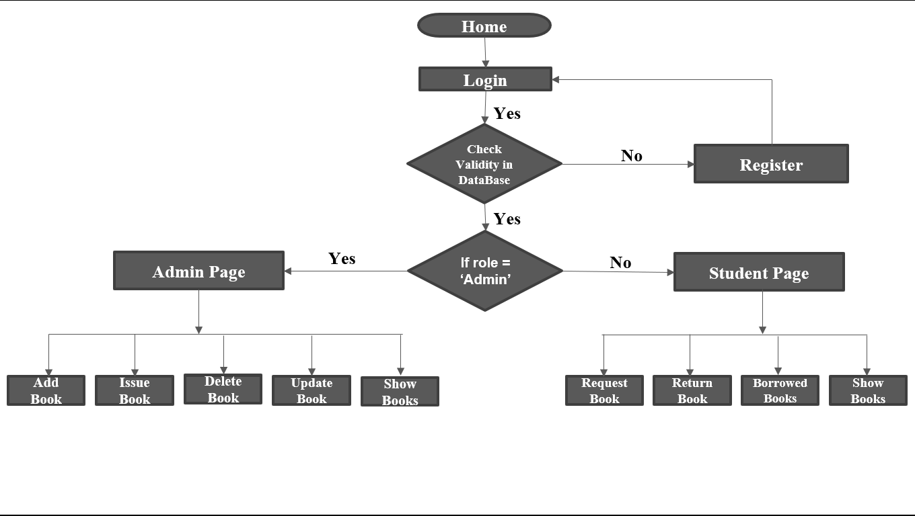
Flow of an execution of a program:

Slide 15
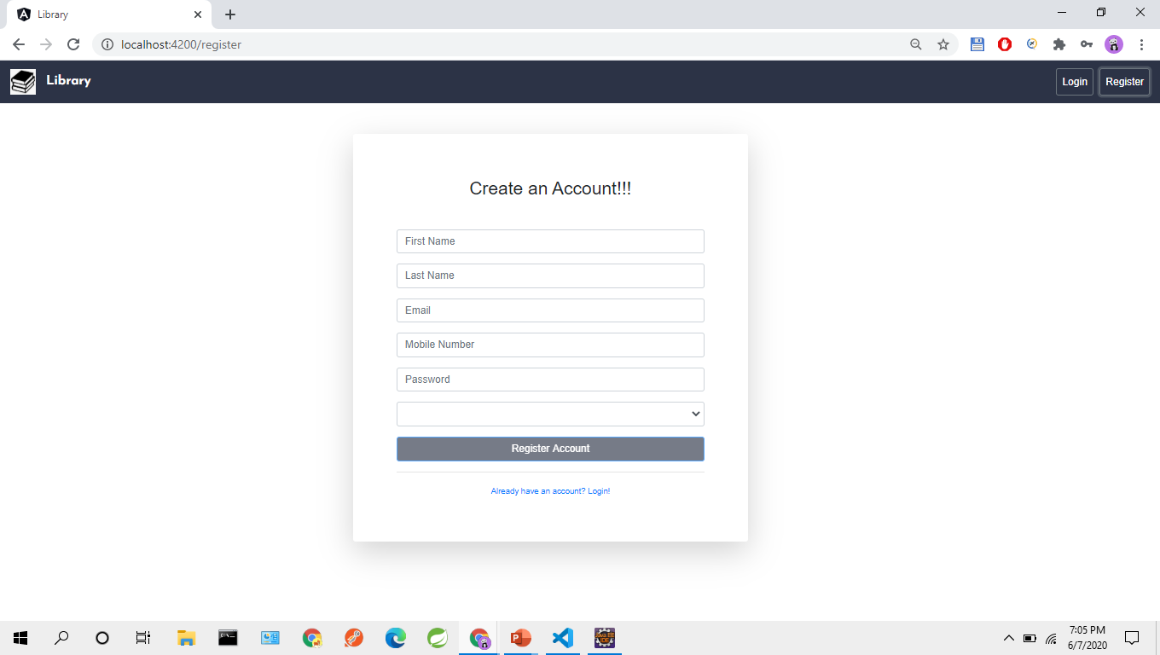
Register Form:

Slide 16
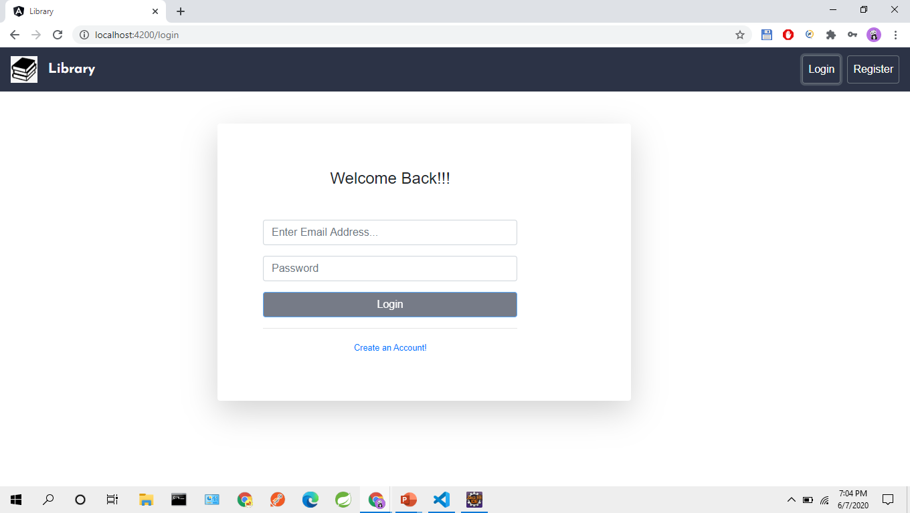

Login Form:

Slide 17
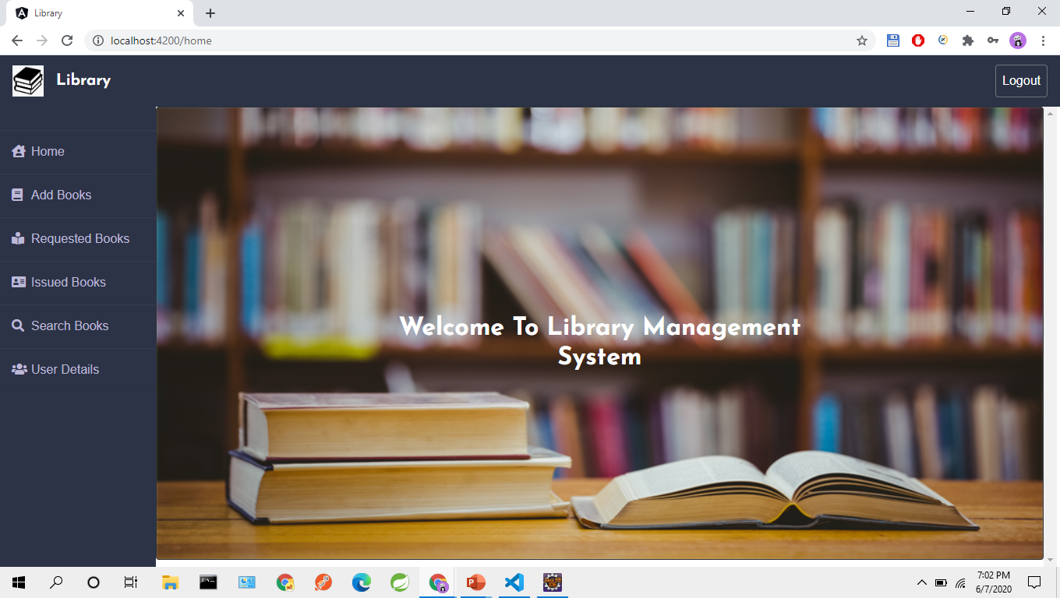
Home Page:

Slide 18
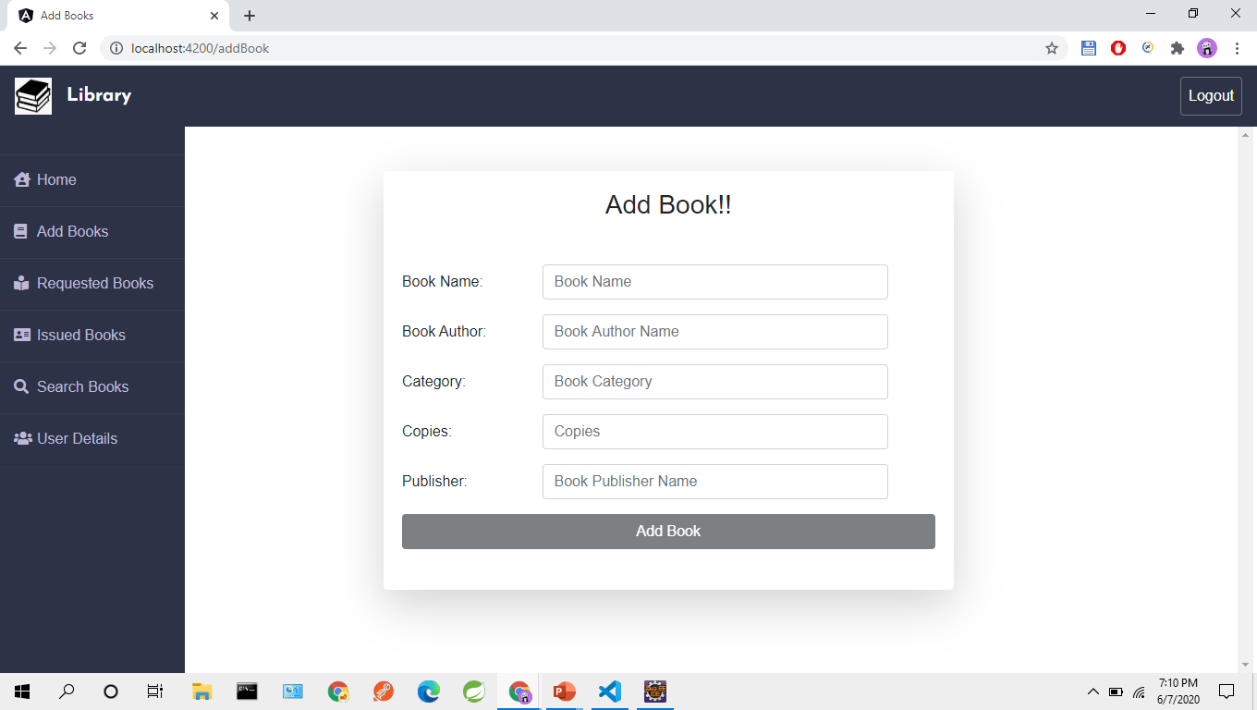
Add Book Form

Slide 19
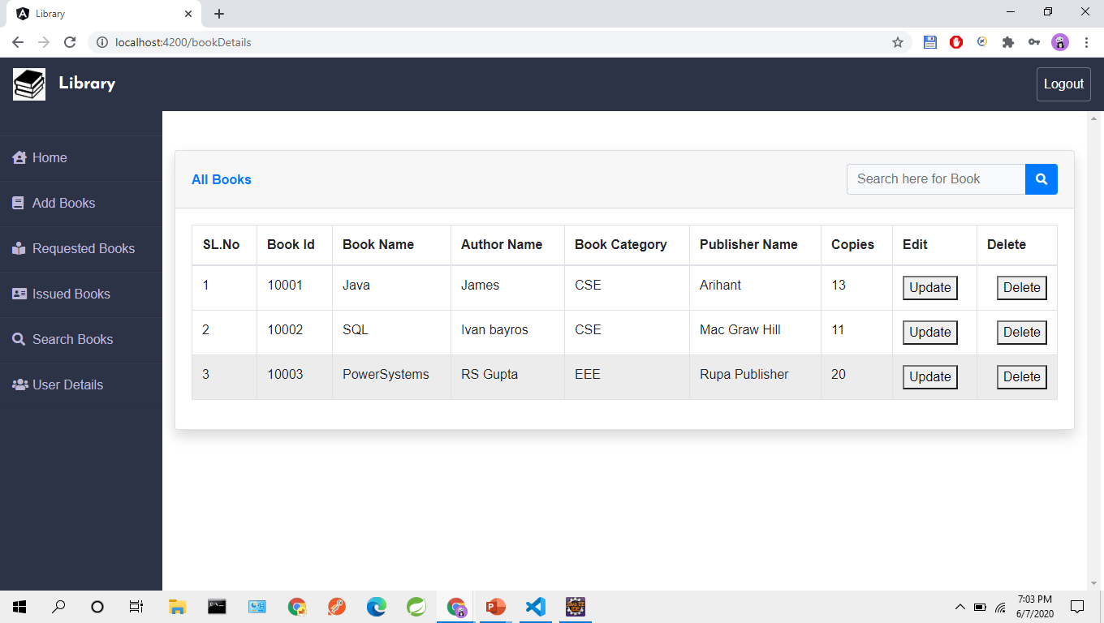
All Books Page:

Slide 20
Conclusion:
The Library Management System which I developed allows the system to store both the user details and books details.
This software allows storing the details of all the data related to library.
The implementation of the system will reduce data entry time and provide readily calculated reports.

Slide 21
Thank You

